Slide 1
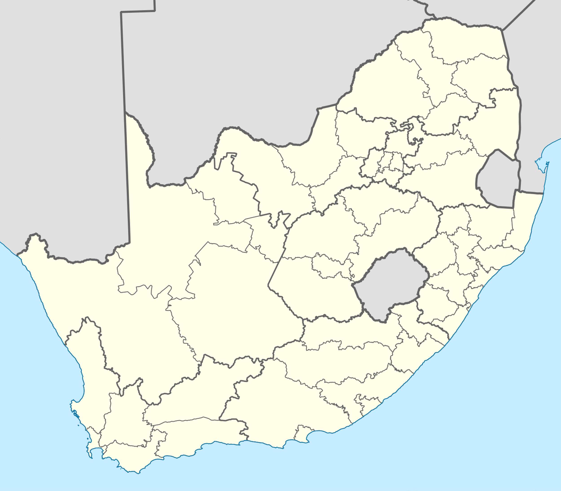
Map of CPD4E interventions
TVET-Colleges:
Eastern Cape
Eastcape Midlands TVET College
Port Elizabeth TVET College
King Hintsa TVET College
Lovedale TVET College
Ingwe TVET College
Free State
Maluti TVET College
Falvius Mareka College
Goldfields TVET College
Gauteng
Ekurhuleni East TVET College
Ekurhuleni West TVET College
Tshwane South TVET College
Tshwane North TVET College
Central Johannesburg TVET College
KwaZulu Natal
uMfolozi TVET College
Umgungundlovu TVET College
Elangeni TVET College
Limpopo
Mopani TVET College
Sekukhune TVET College
Lephalale TVET College
Lethaba TVET College
Waterberg TVET College
Vhembe TVET College
Mpumalanga
Gert Sibande TVET College
Nkangala TVET College
North West
Orbit TVET College
Vuselela TVET College
Western Cape
Boland College
South Cape College
West Coast College
False Bay College
Northlink College
SMME support Hubs:
Western Cape
West Coast College, Atlantis
False Bay College, Khayelitsha
South Cape College
KwaZulu Natal
Umfolozi College, Mandeni
Mpumalanga
Gert Sibande College, Evander
Gauteng
Tshwane North College, Mamelodi
Ekurhuleni West College, Kathlehong
Other training & research facilities
Lulalab Johannesburg
YES hub Johannesburg
YES hub Saldhana Bay
Resolution Circle at University of Johannesburg
IEPA Energy Training and Assessment Center
SARETEC
Durban University of Technology
University of the Witswatersrand
CPD4E Interventions

